Slide 1
Analysis and Visualization of Biological Networks
John “Scooter” Morris, Ph.D.
Resource for Biocomputing, Visualization, and Informatics, UCSF

Slide 2
Caveats
Research in biological network analysis requires…
  in-depth knowledge of graph theory
    Which I’m not sure I have…
  strong background in statistics
    Which I know I don’t have…
  strong background in biology
    Which I *think* I have…
I’m not going to talk about cutting edge research
I’m going to introduce some of the approaches and tools only

Slide 3
So, why am I here?
Executive Director: NIH Resource for Biocomputing, Visualization, and Informatics
19 Years of Pharmaceutical Experience (Genentech)
Cytoscape core team (4 years)
Author:
  Cytoscape layout mechanism
  Cytoscape group mechanism
  Metanode Plugin
  clusterMaker
  chemViz
  structureViz
Executive Director: NIH Resource for Biocomputing, Visualization, and Informatics
19 Years of Pharmaceutical Experience (Genentech)
Cytoscape core team (4 years)
Author:
  Cytoscape layout mechanism
  Cytoscape group mechanism
  Metanode Plugin
  clusterMaker
  chemViz
  structureViz

Slide 4
Why are you here?
Bench biologists?
Geneticists?
Bioinformaticists?
Mathematians?
Cheminformaticians?
Structural biologists?

Slide 5
Outline
The Challenge
Biological network taxonomy
Analytical approaches
Visualisation approaches
  Data mapping
  Layouts
Tools
  Cytoscape

Slide 6
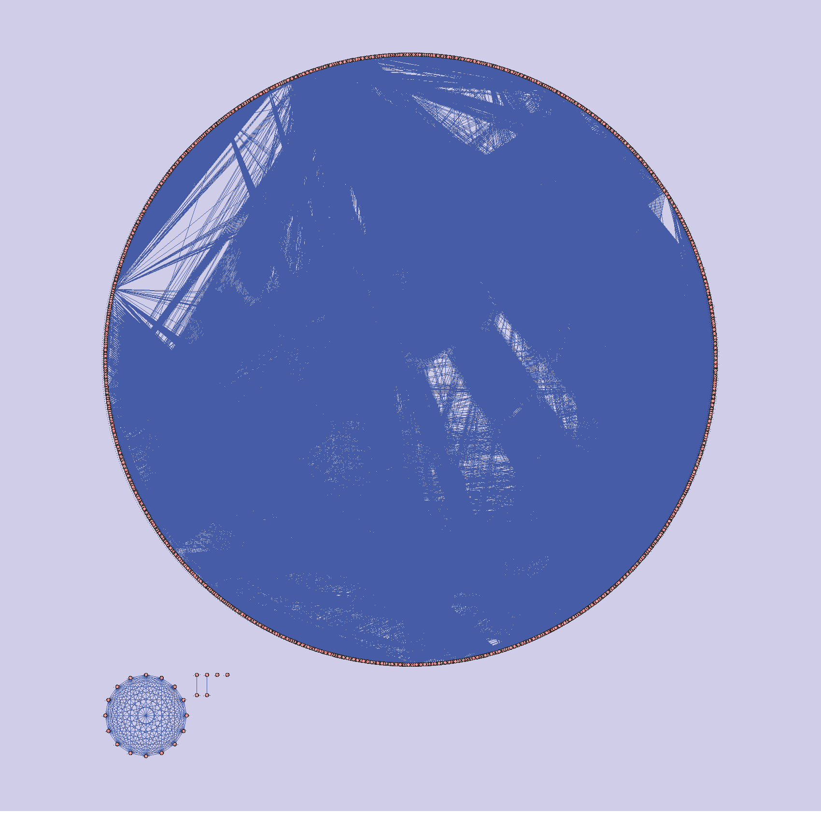
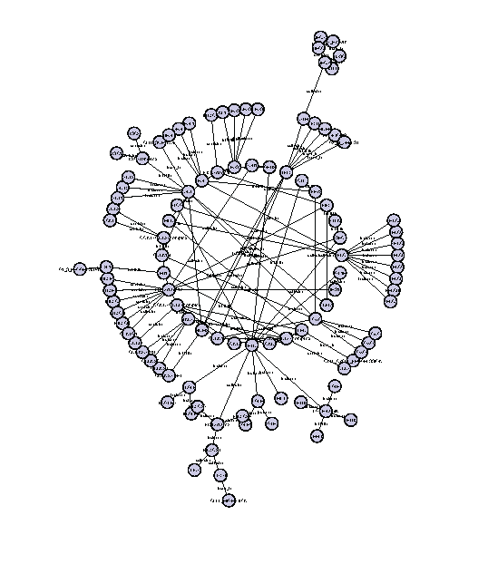
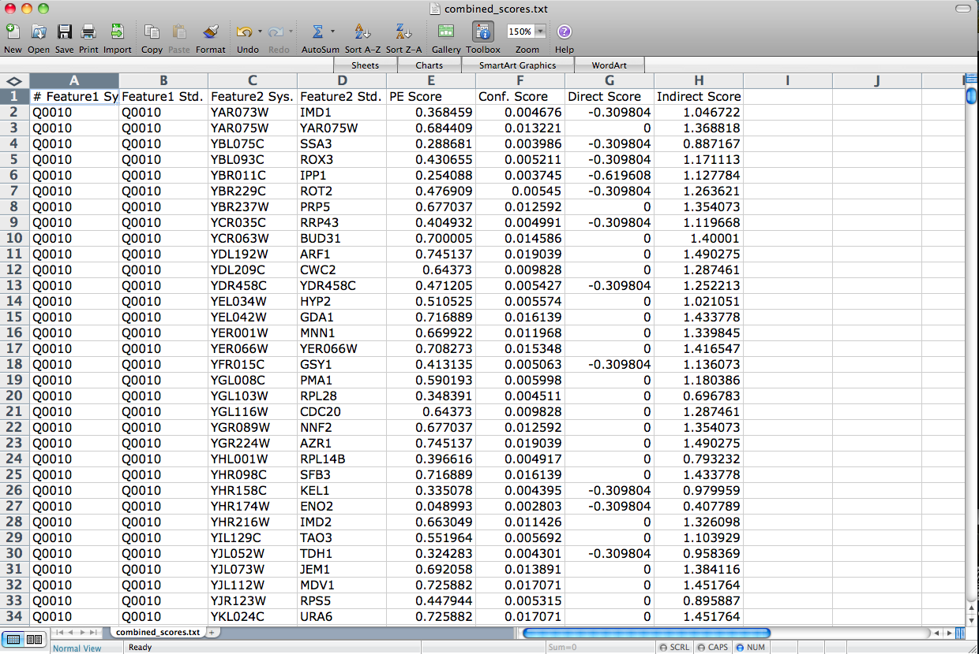
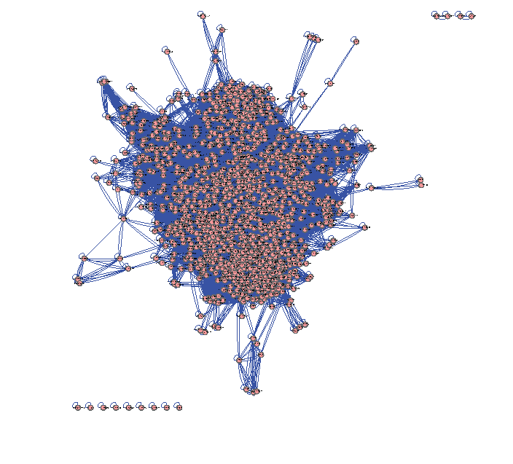

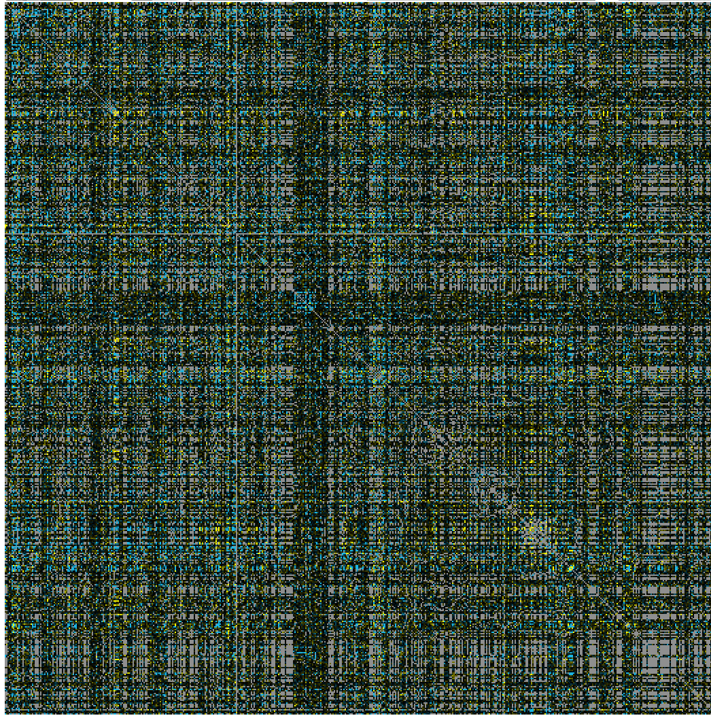
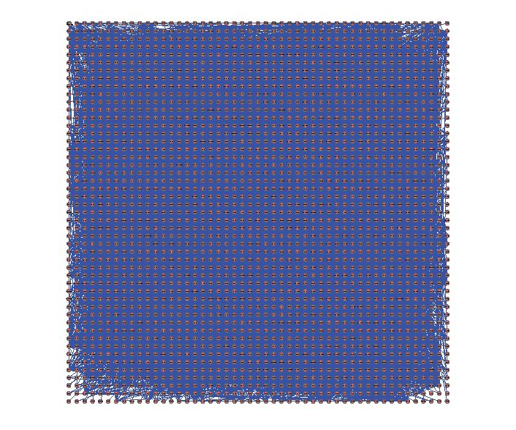
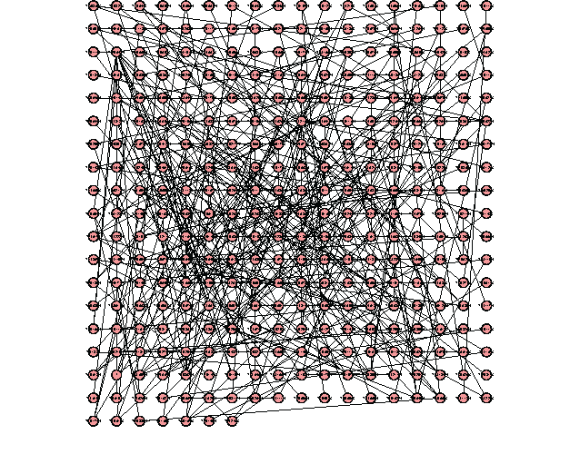
The Challenge
Making sense out of biological networks….

Slide 7
The Challenge
Biological networks (nodes and edges)
  Seldom tell us anything by themselves
  Analysis involves:
    Understanding the characteristics of the network
      Modularity
      Comparison with other networks (specifically random networks)
  Visualization involves:
    Placing nodes in a meaningful way (layouts)
    Mapping biologically relevant data to the network
      Node size
      Node color
      Edge weights

Slide 8
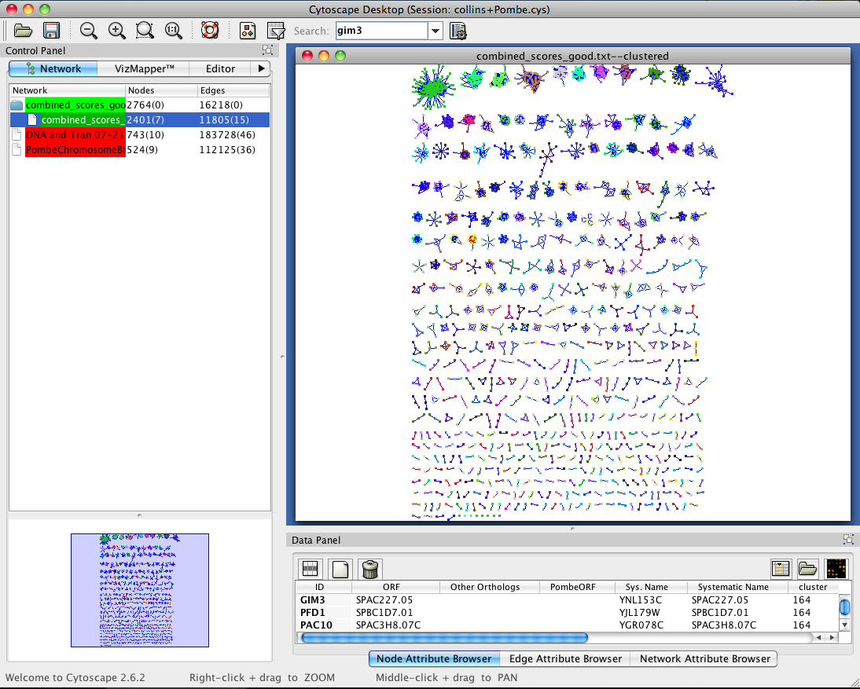
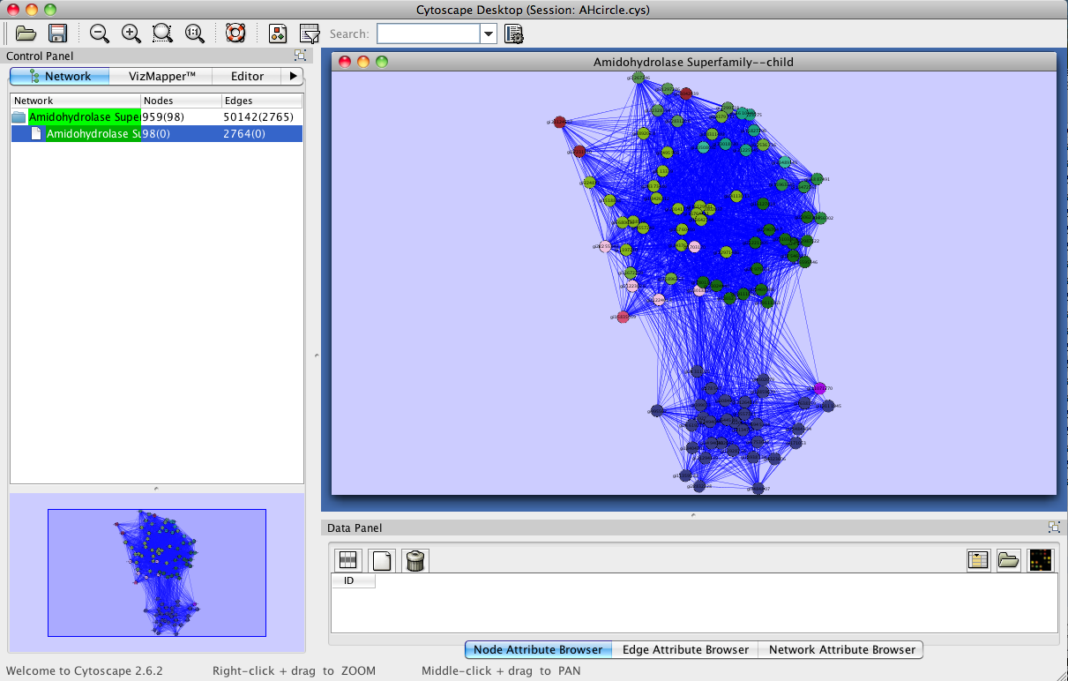
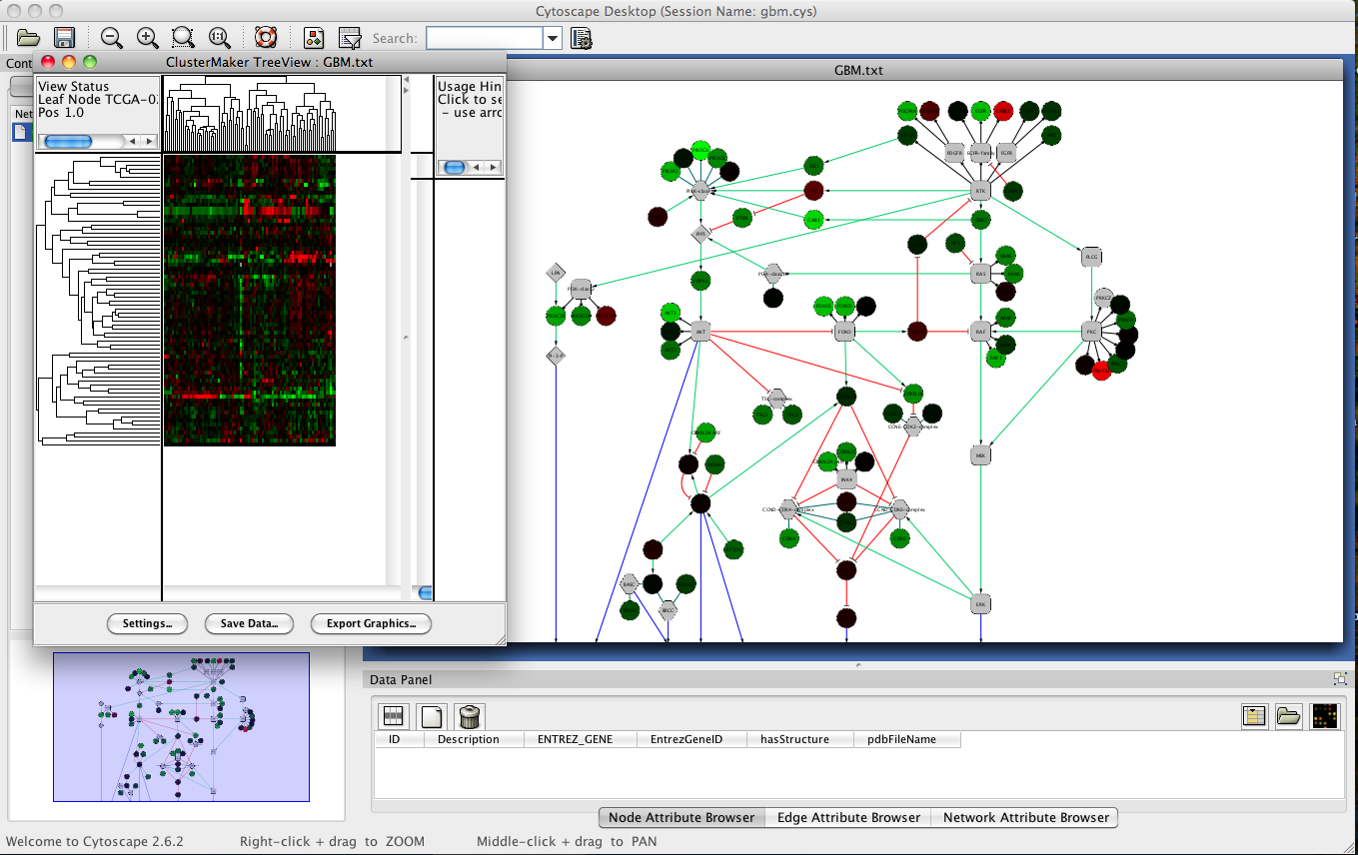
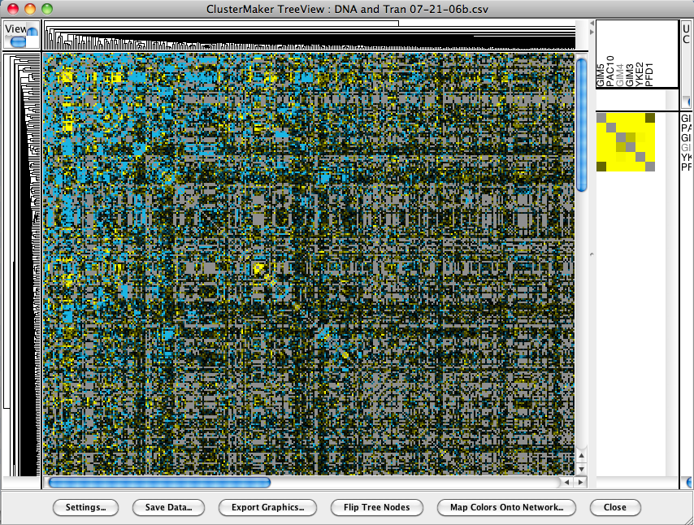
The Challenge

Slide 9
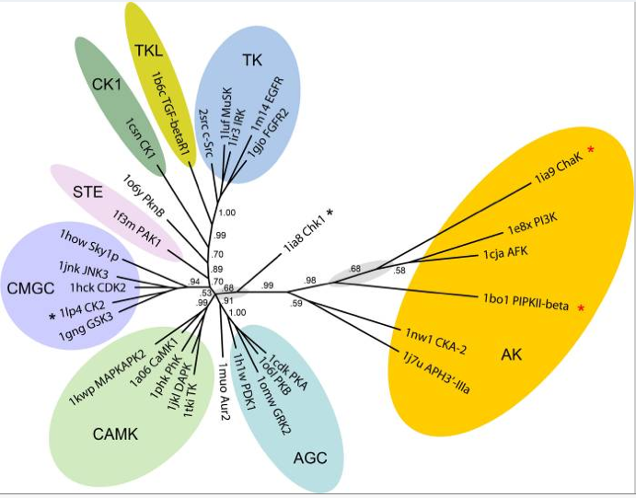
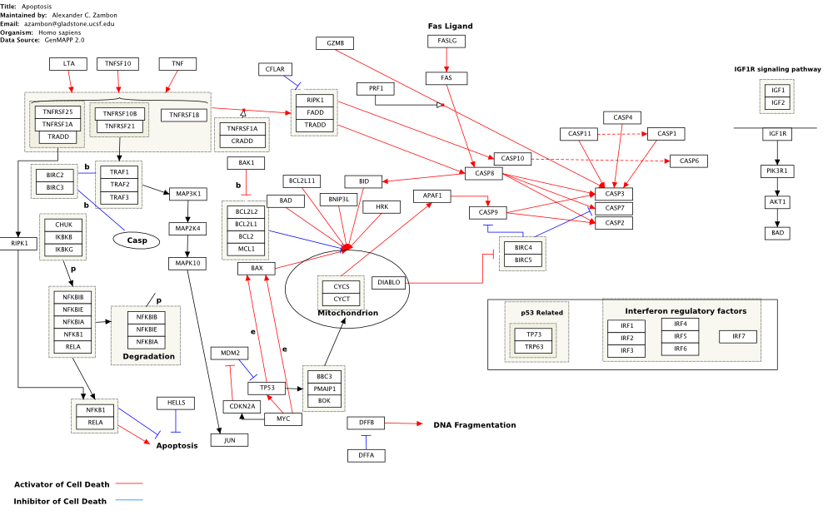
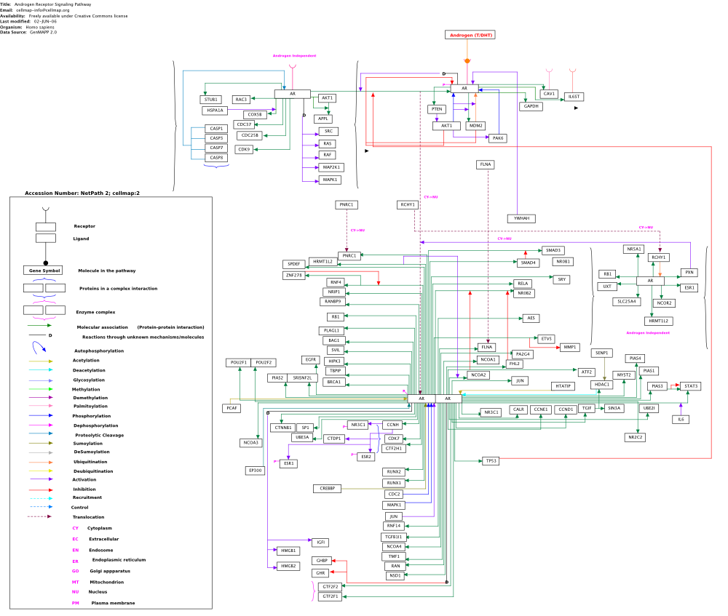
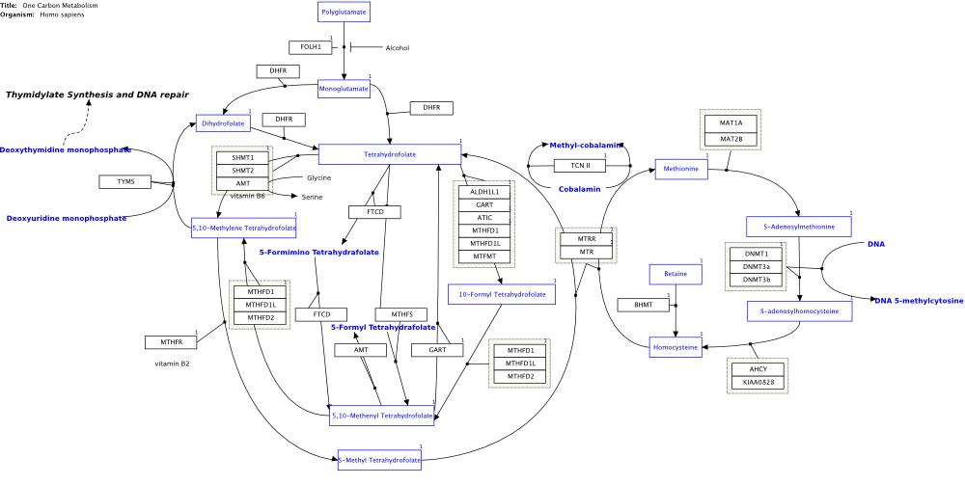
Biological Network Taxonomy
Pathways
  Signaling
  Metabolic
  Regulatory
  Phylogeny (could also be thought of as similarity)
Notes:
Signaling pathway: Androgen Receptor Signaling Pathway
Metabolic pathway: One Carbon pathway

Slide 10
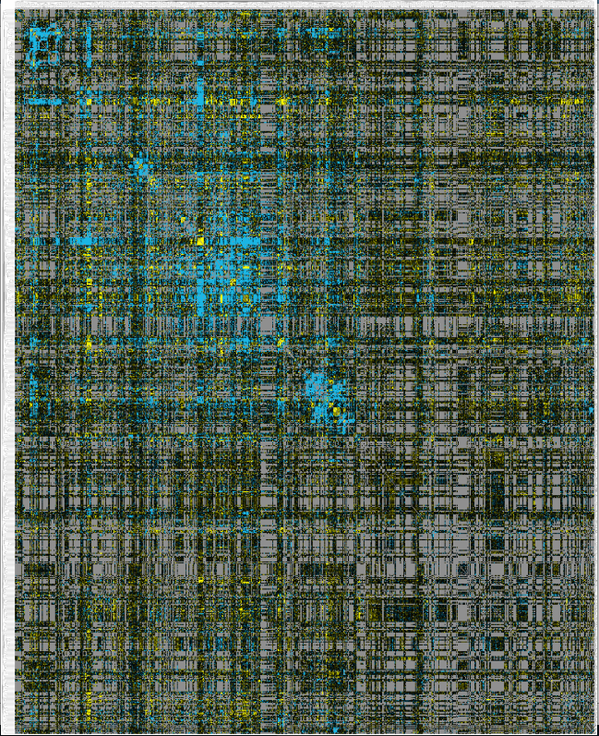
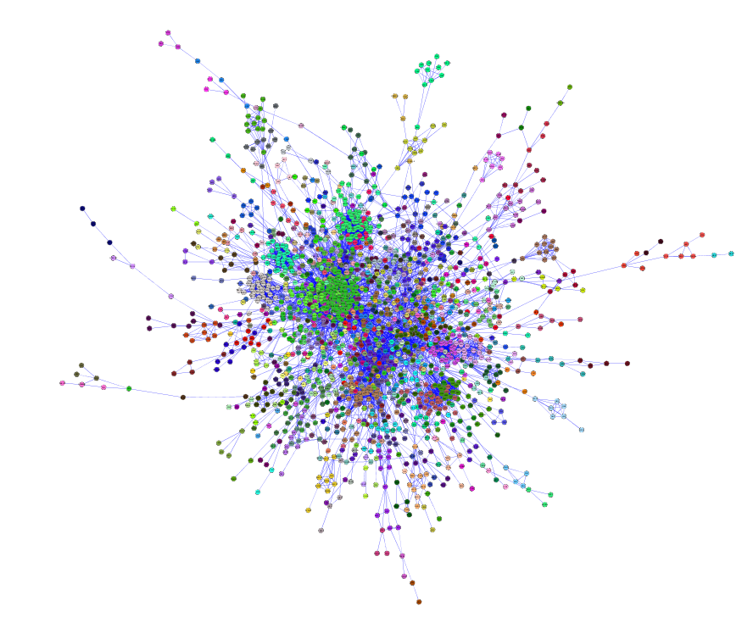
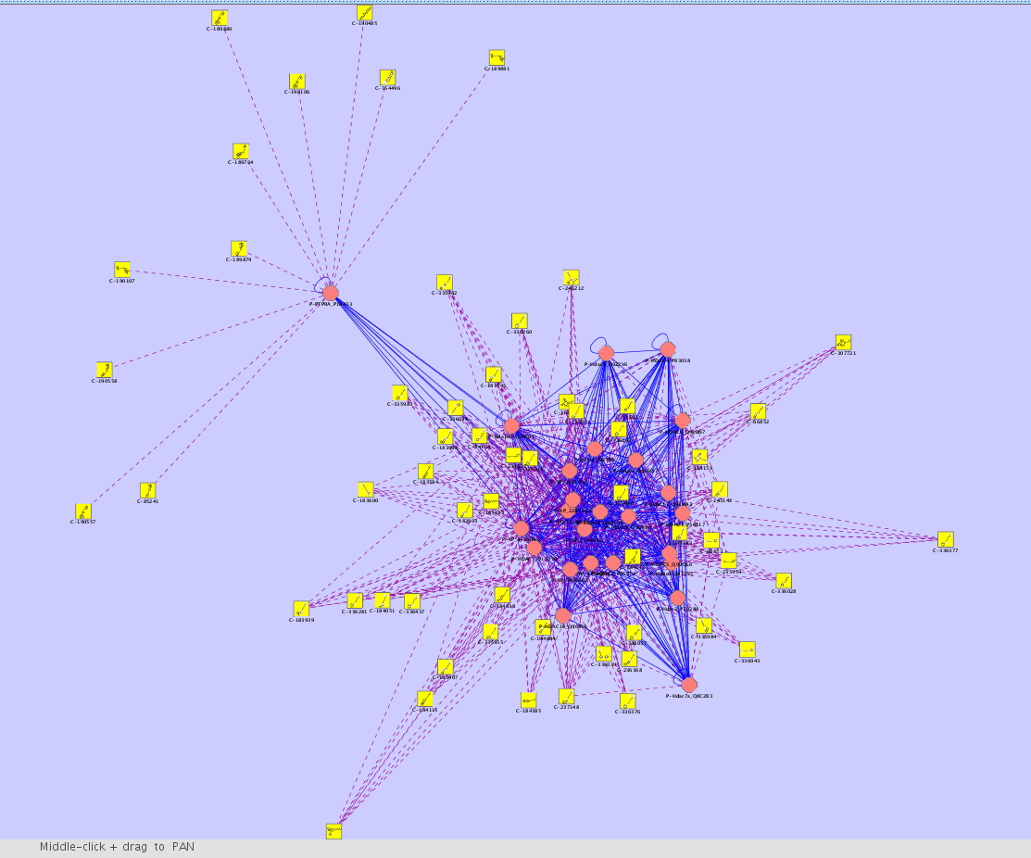
Biological Network Taxonomy
Interactions
  Protein-Protein interactions
  Protein-Ligand interactions
  Genetic interactions
  Domain-Domain interactions
  Others
    Residue or atomic interactions
    Cell/cell interactions
    Population biology
    Epidemiology
    Social networks

Slide 11
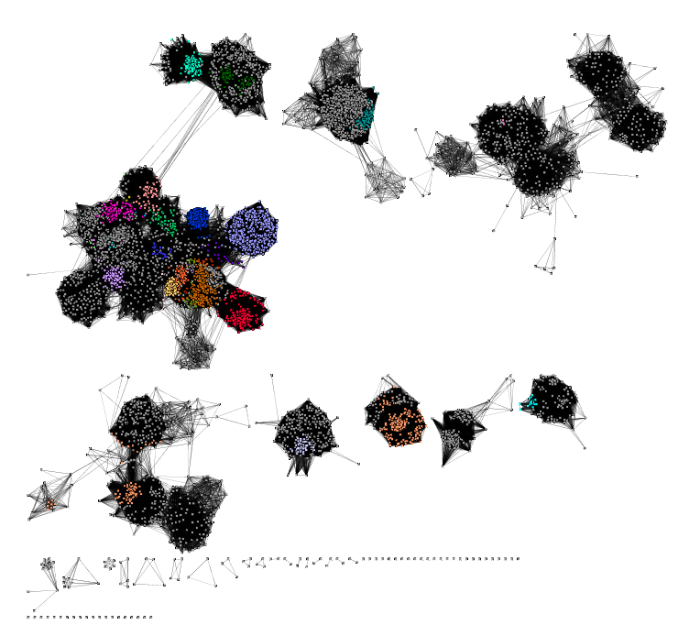
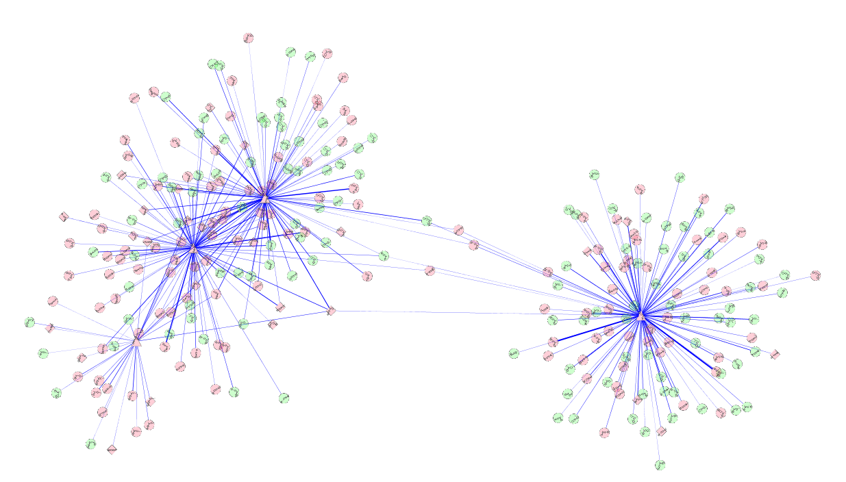
Biological Network Taxonomy
Similarity
  Protein-Protein similarity
  Chemical similarity
  Ligand similarity (SEA)
  Others
    Tag clouds
    Topic maps

Slide 12
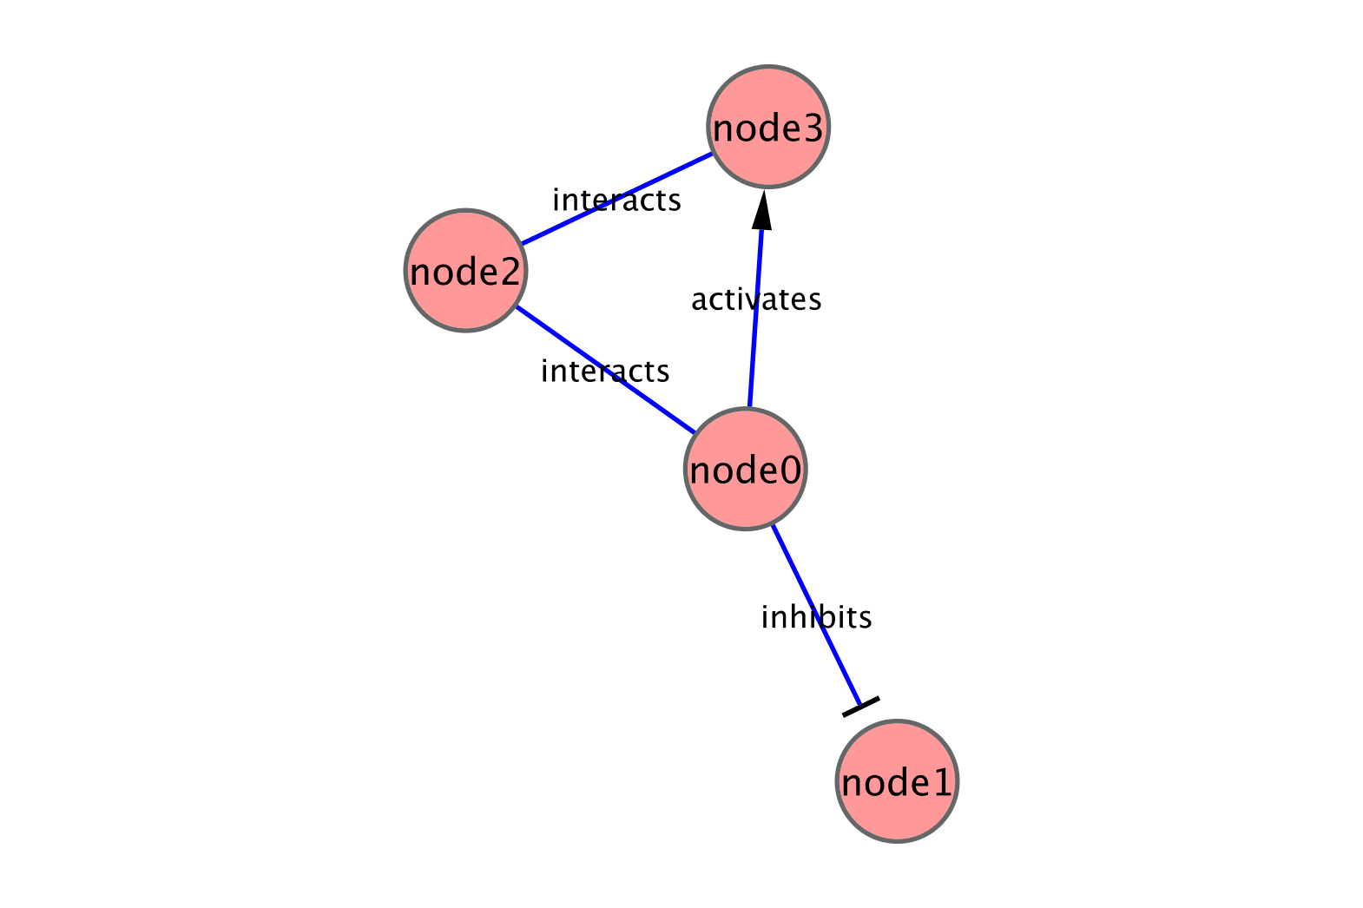
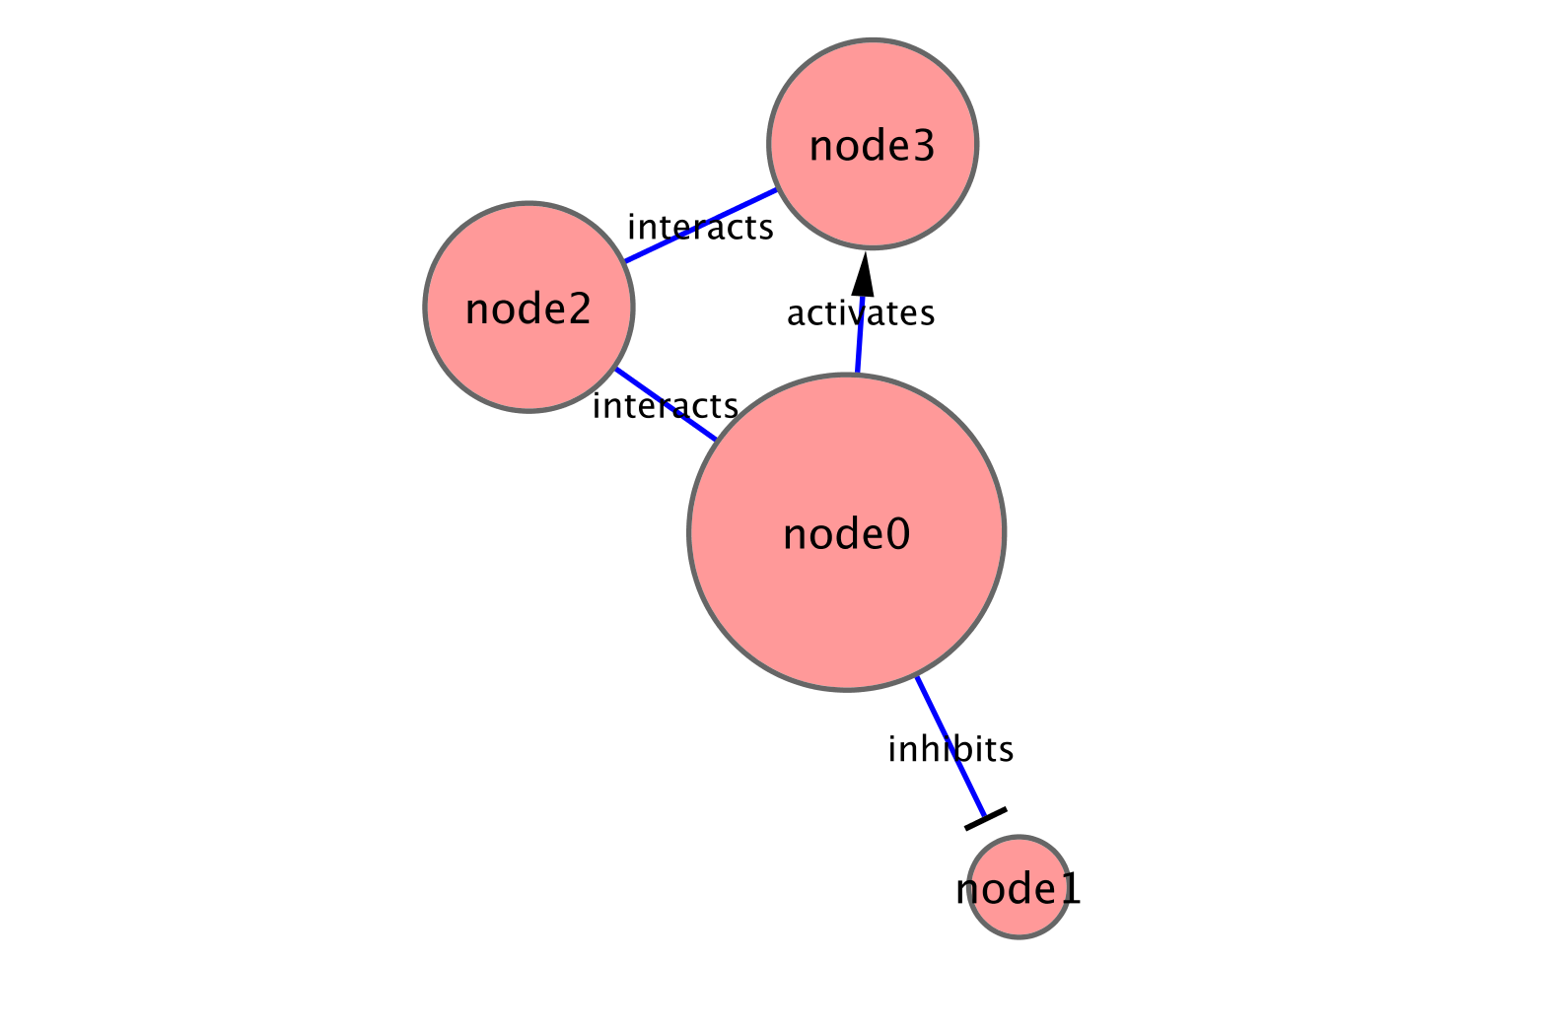
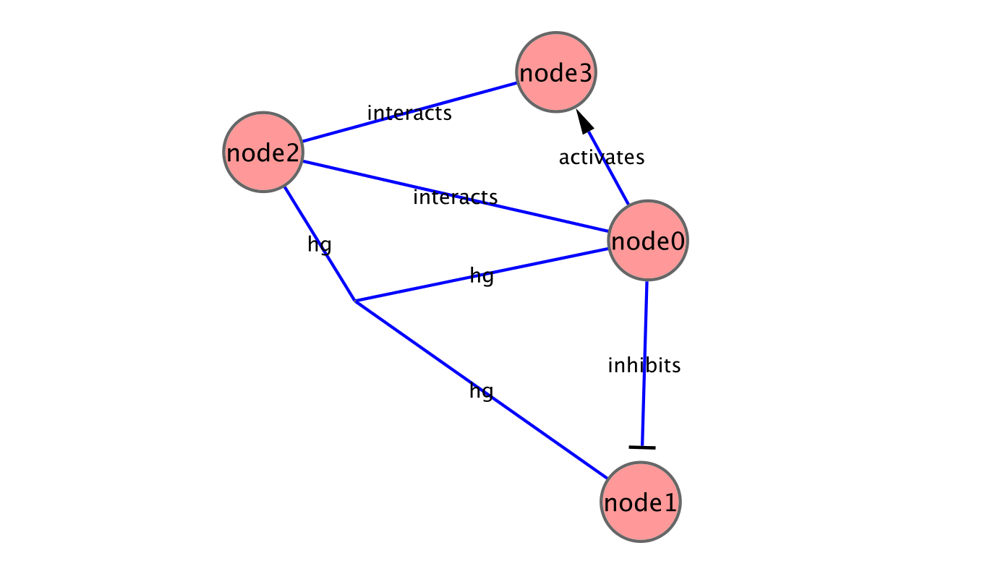
Analytical approaches
Concepts
  Graph/Network correspondence
  Node/Vertex correspondence
  Edge directedness
    Usually a network property
  Node degree
  Hypergraph
    Allow edges to connect more than 2 nodes

Slide 13
Analytical approaches
Scale-free networks
  Degree distribution follows power law: P(k) ~ k^{-γ}, where γ is a constant.
  Result is that there are distinctive “hubs” (essential proteins?)
  Overall, though, network is resilient to perturbation
  Biological (and social) networks tend to be scale-free

Slide 14
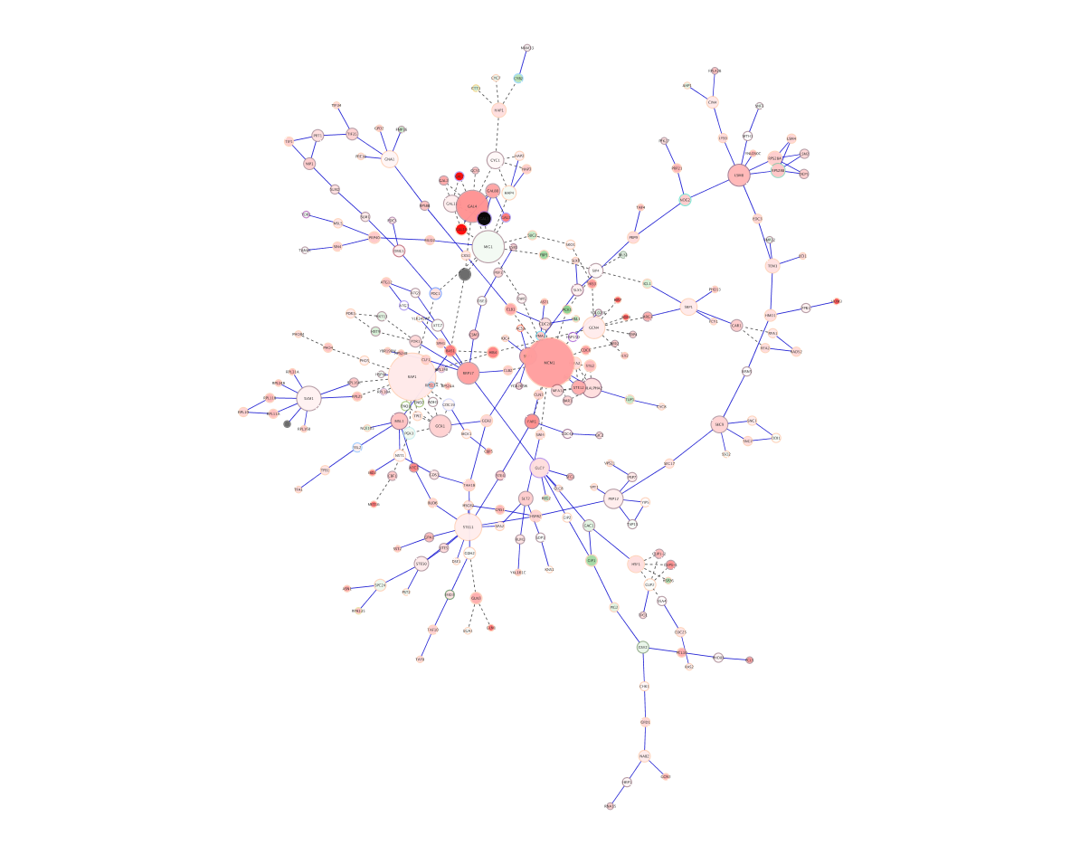
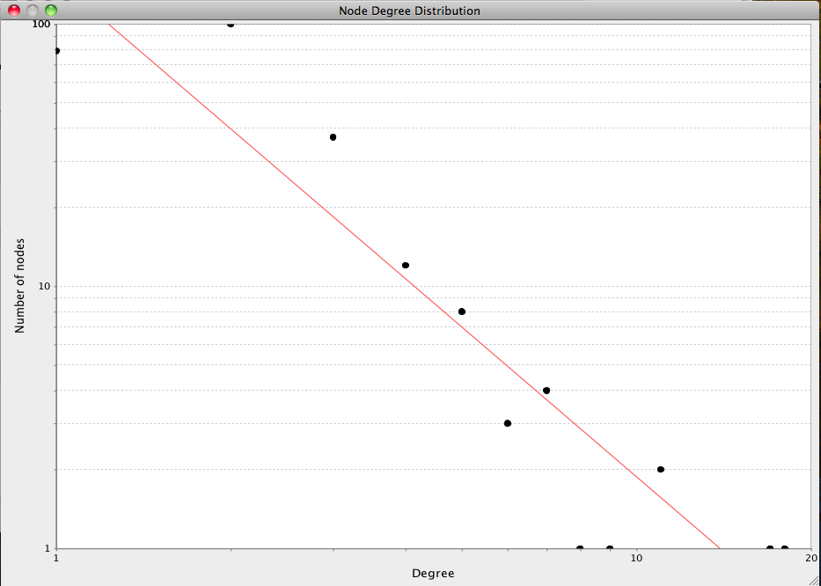
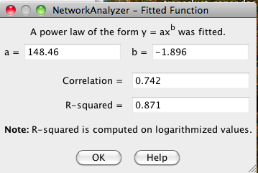
Analytical approaches
Random networks
  Algorithms exist to create random networks
    Flat random network: Erdos-Renyi
    High clustering coefficient: Watts-Strogatz
    Scale-free: Barabasi-Albert
  Nodes have similar degrees
  Useful to compare your network vs. a random network

Slide 15
Analytical approaches
Hierarchical networks

Slide 16
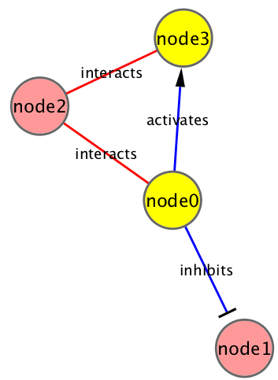
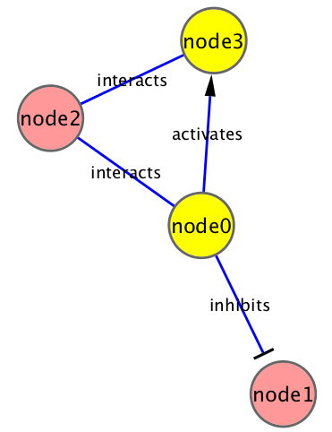
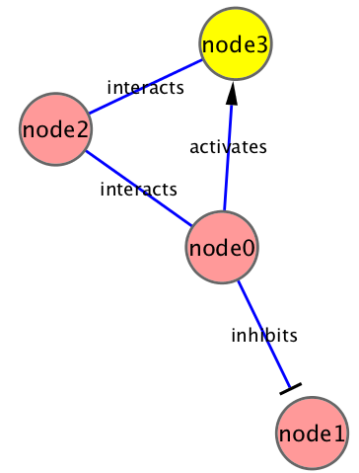

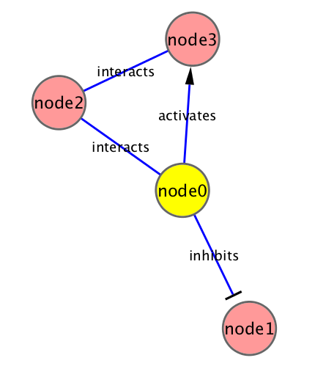
Analytical approaches
Network measures
  Node degree
    Node indegree: # of edges for which this node is a target
    Node outdegree: # of edges for which this node is a source
  Shortest path length
    Shortest traversal distance between two nodes
    Can be weighted if edges have weights or hops if not

Slide 17
Analytical approaches
Network measures
  Node degree
    Node indegree: # of edges for which this node is a target
    Node outdegree: # of edges for which this node is a source
  Shortest path length
    Shortest traversal distance between two nodes
    Can be weighted if edges have weights or hops if not
  Clustering coefficient
    Measures how close the neighbors of a node are to being a clique (fully connected group)
    # of edges connecting a node’s neighbors/the node’s degree
1
.5
.3
0

Slide 18
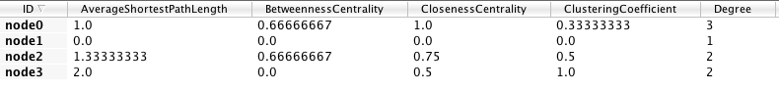
Analytical approaches
Centrality - measures of node importance
  Degree centrality (find hubs)
    Degree of this node / (# of nodes – 1)
  Betweenness centrality (essentiality)
    The average number of shortest paths that go through this node
  Closeness centrality
    The sum of all shortest paths between this node and all other nodes / (# of nodes – 1)
Notes:
Switch to Cytoscape to show

Slide 19
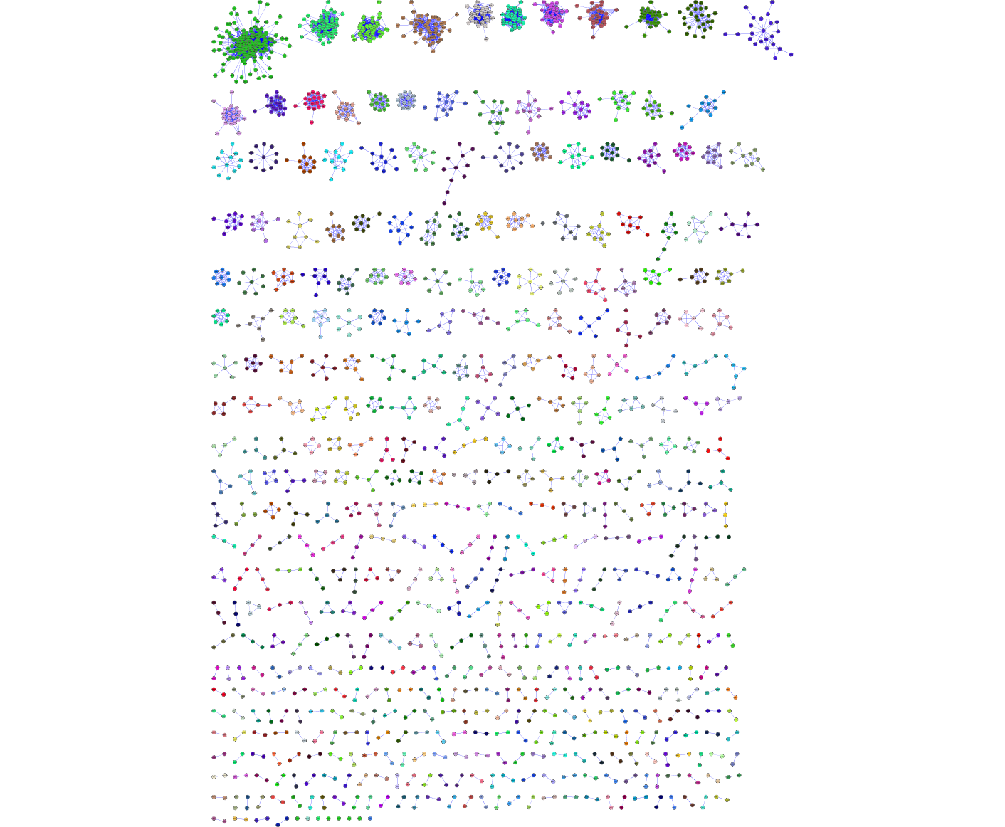
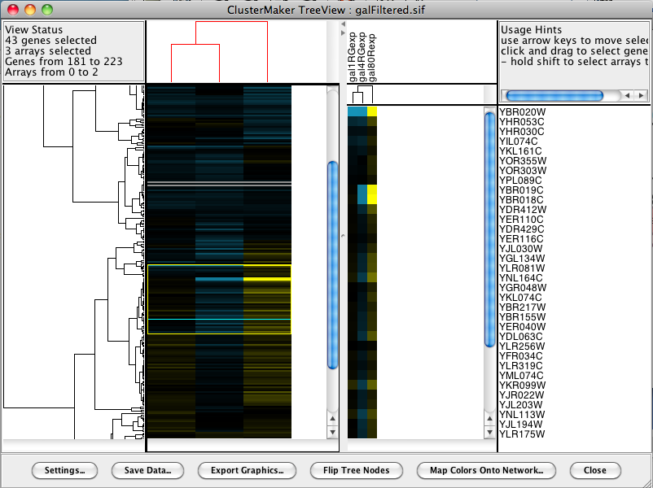
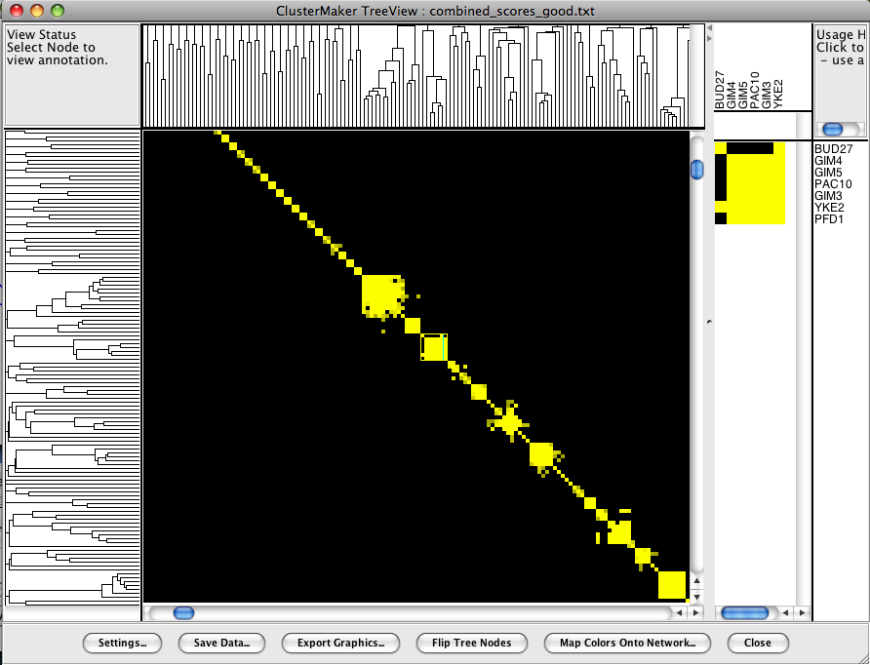
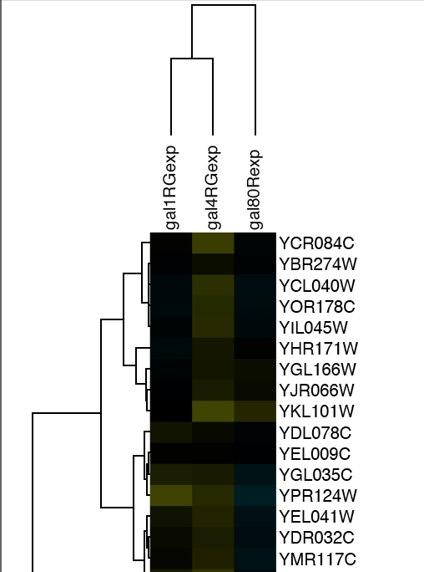
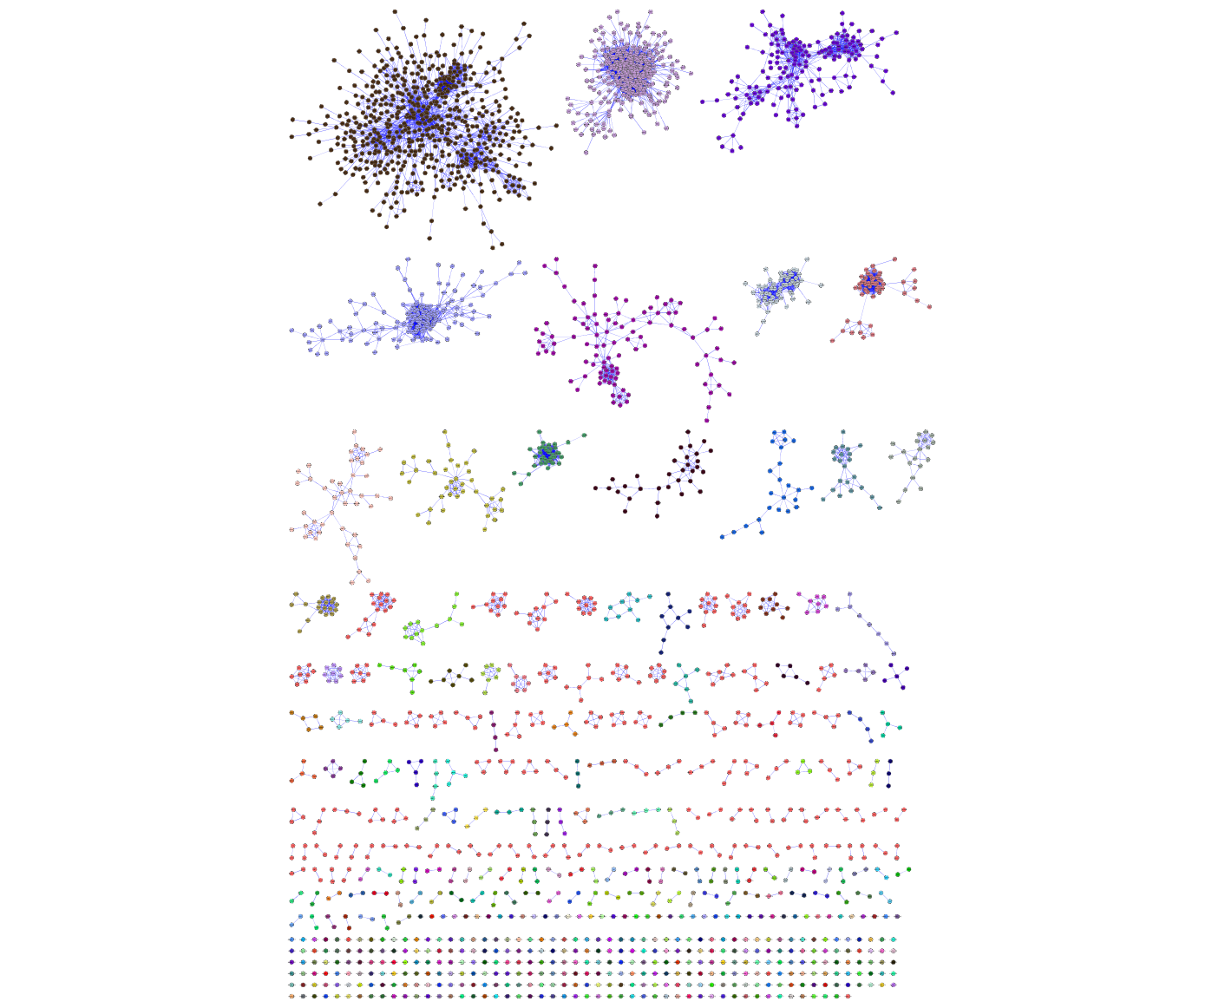
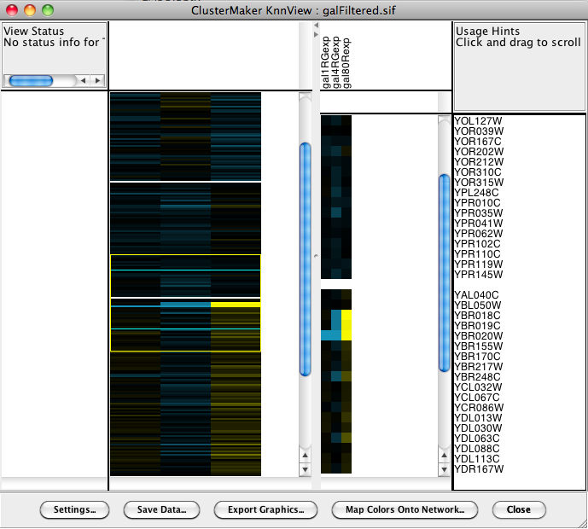
Analytical approaches
Clustering (find hubs, complexes)
  Goal: group related items together
Clustering types:
  Hierarchical clustering
    Divide network into pair-wise hierarchy
  K-Means clustering
    Divide network into k groups
  MCL
    Uses a flow simulation to find groups
  Community Clustering
    Maximize intra-cluster edges vs. inter-cluster edges

Slide 20
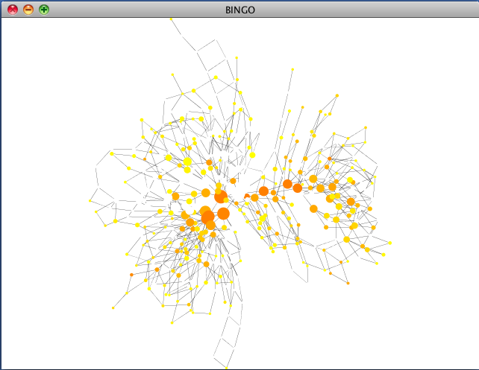

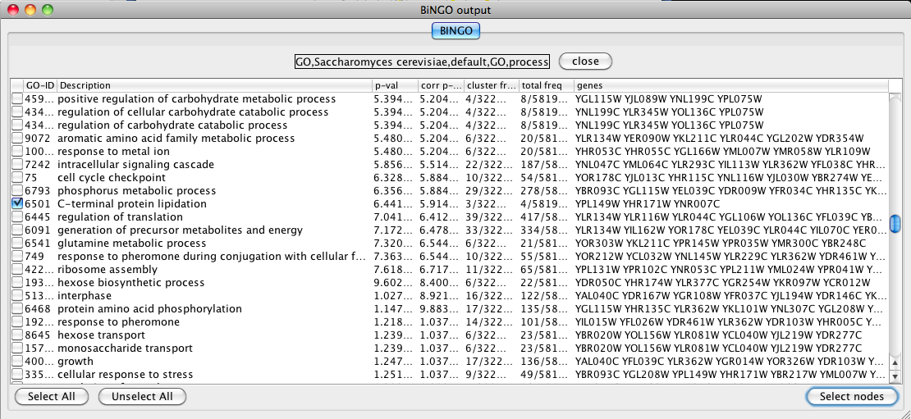
Analytical approaches
Motif finding
  Search directed networks for network motifs (feed-forward loops, feedback loops, etc.)
  Already discussed in introduction….
Overrepresentation analysis
  Find terms (GO) that are statistically overrepresented in a network
  Not really a network analysis technique
  Very useful for visualization

Slide 21
Visualisation approaches
Data mapping
Layouts
Animation

Slide 22
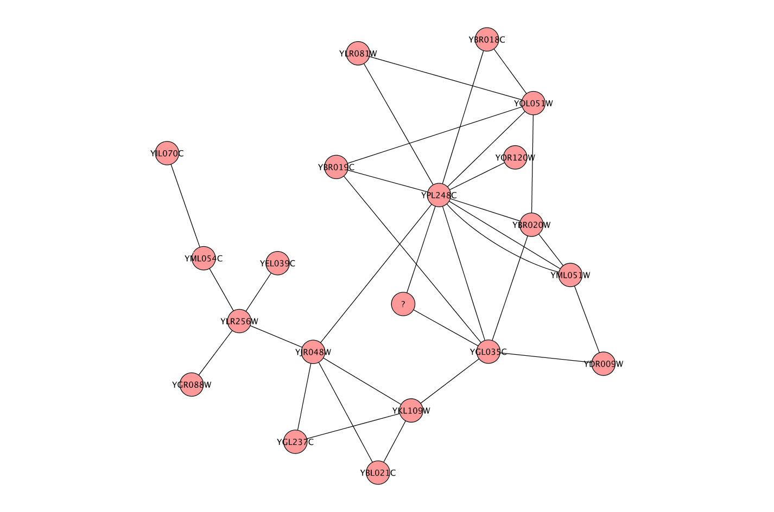
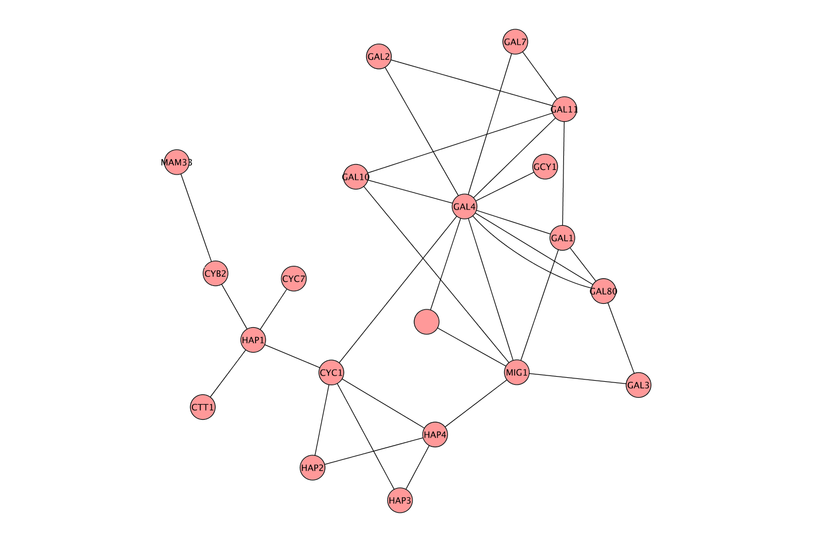
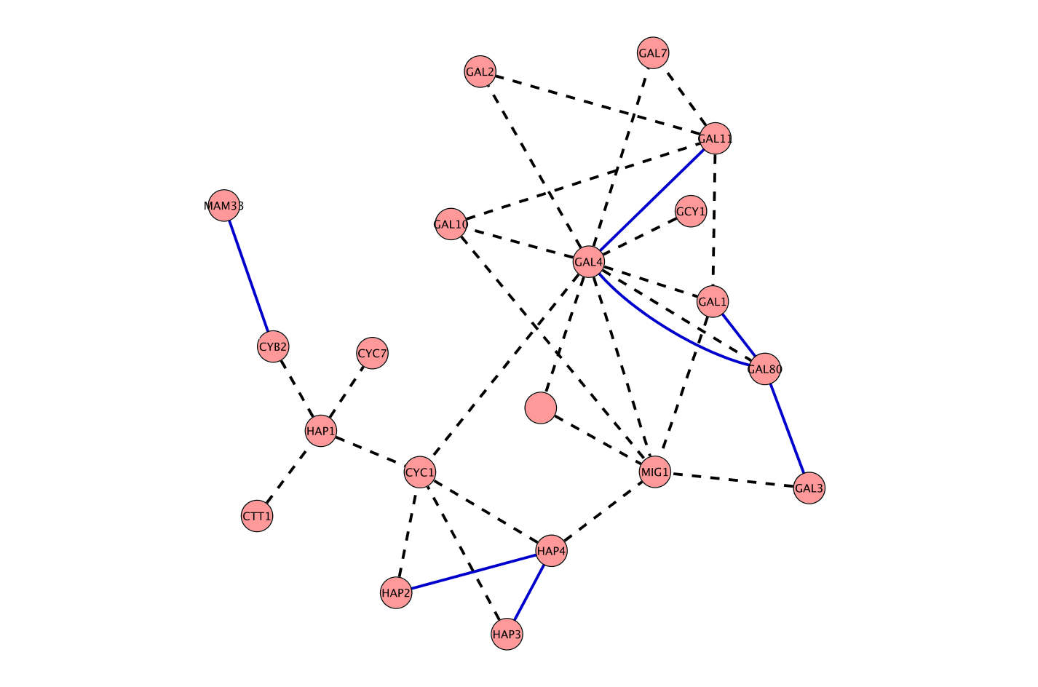
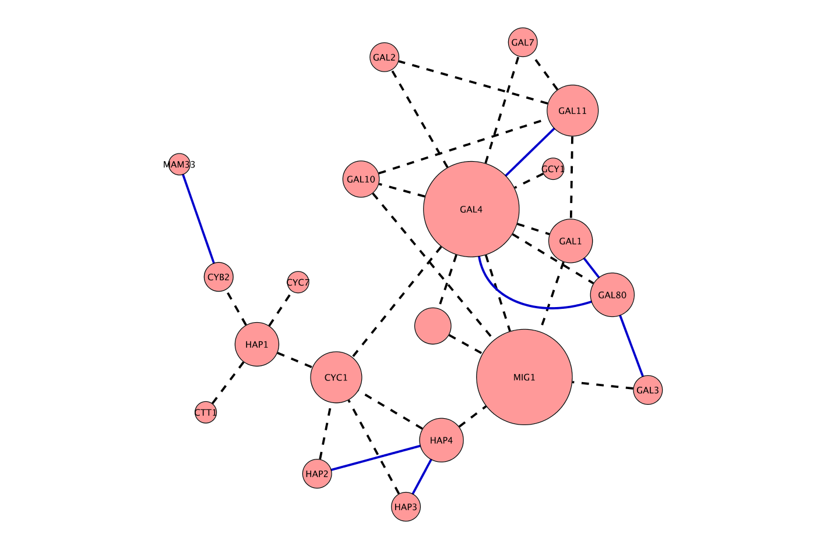
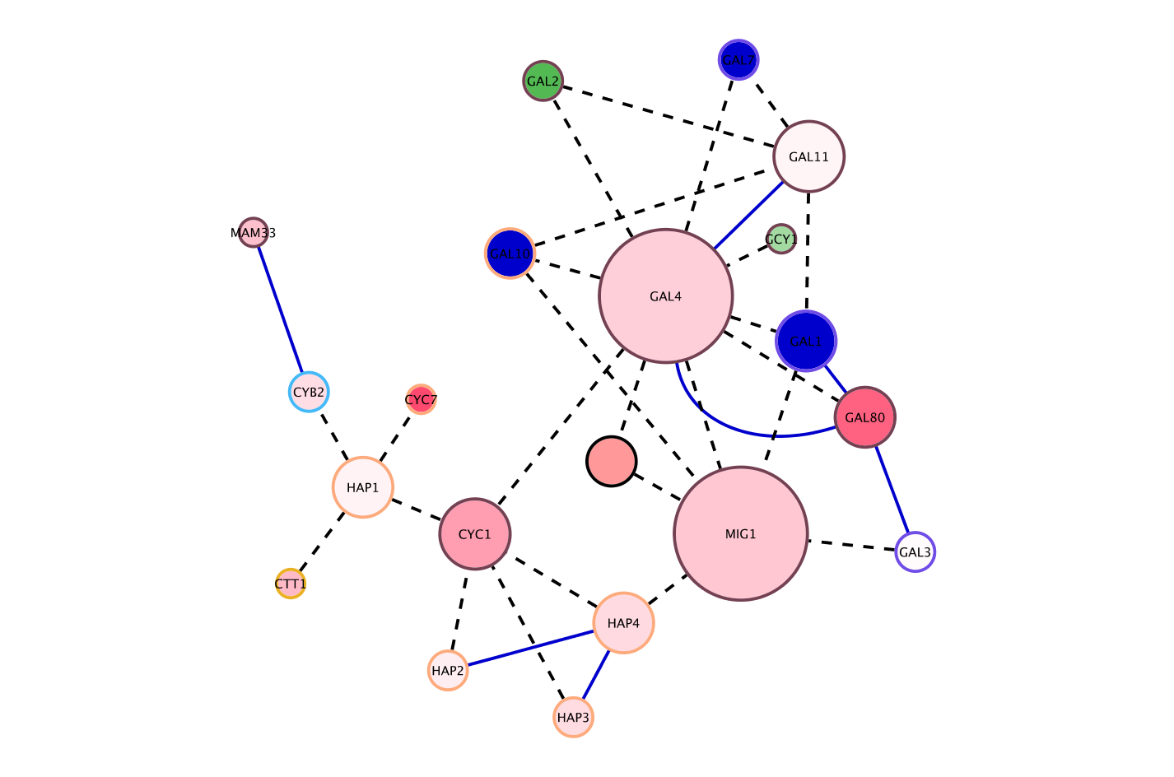
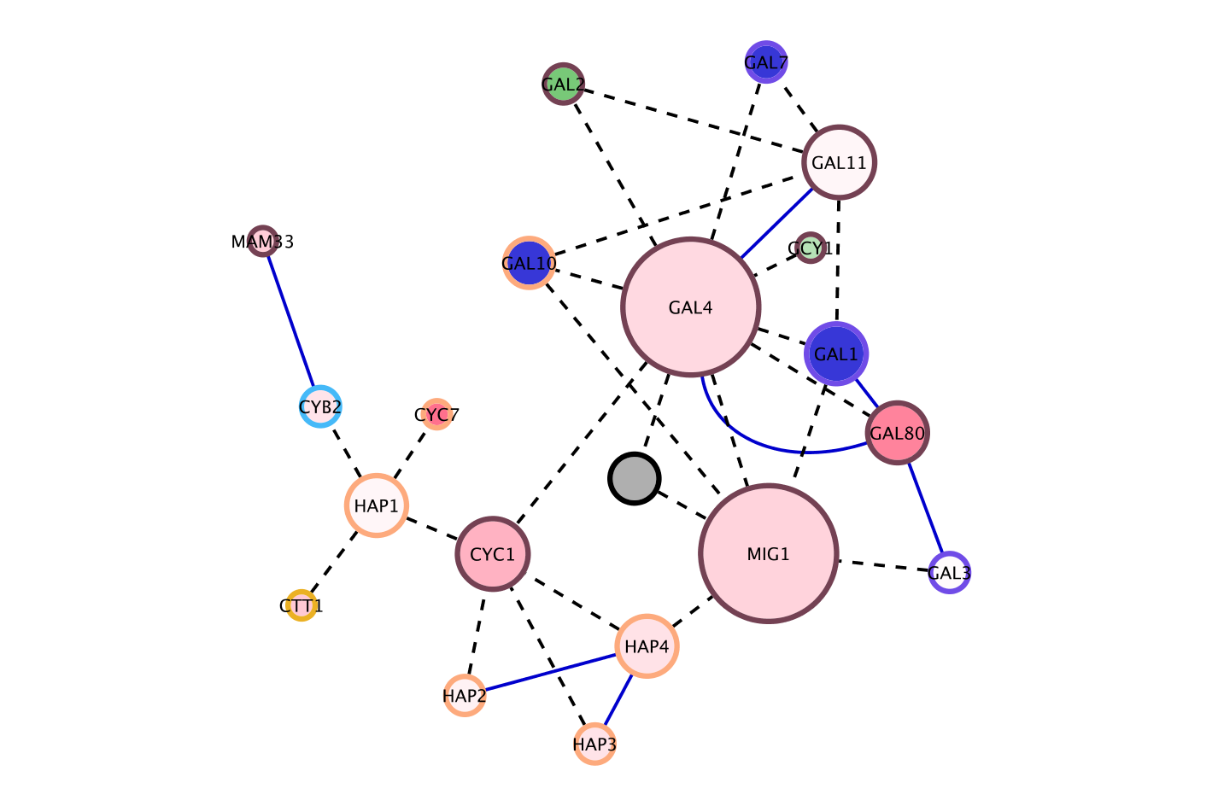
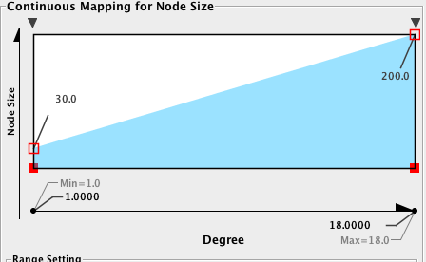
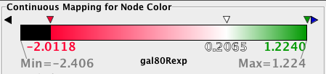
Data mapping
Mapping of data values associated with graph elements onto graph visuals
Visual attributes
  Node fill color, border color, border width, size, shape, opacity, label
  Edge type, color, width, ending type, ending size, ending color
Mapping types
  Passthrough (labels)
  Continuous (numeric values)
  Discrete (categories)
Notes:
Add some examples

Slide 23
Data mapping
Avoid cluttering your visualization with too much data
  Map the data you are specifically interested in to call out meaningful differences
  Mapping too much data to visual attributes may just confuse the viewer
  Can always create multiple networks and map different values
Notes:
Add counter examples

Slide 24
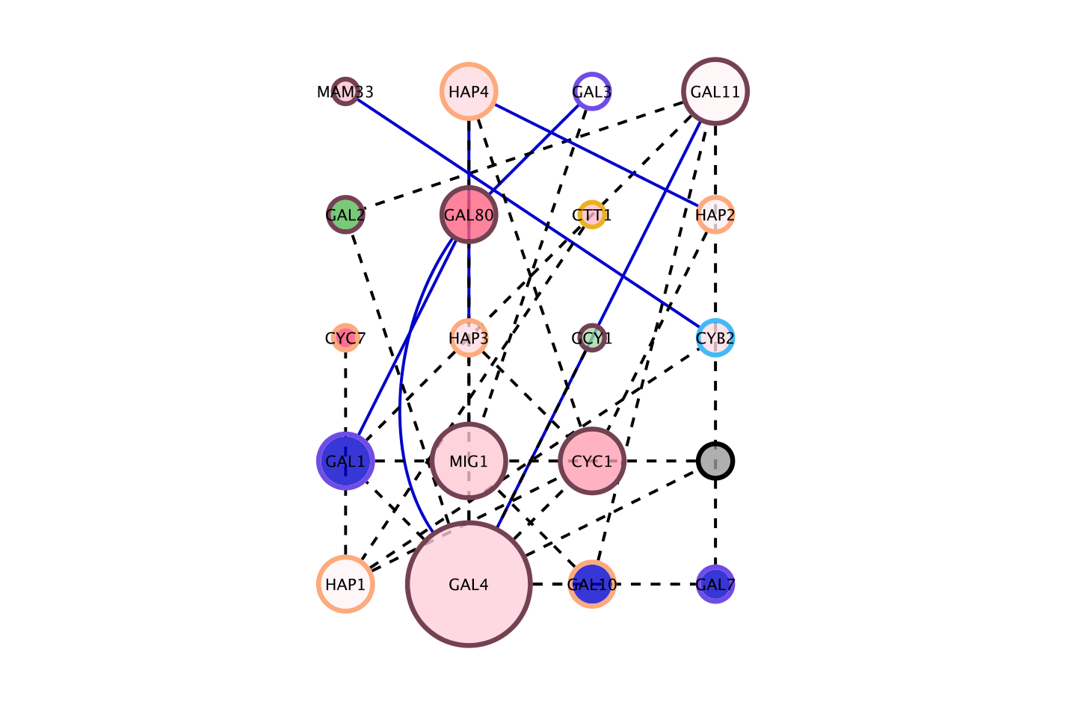
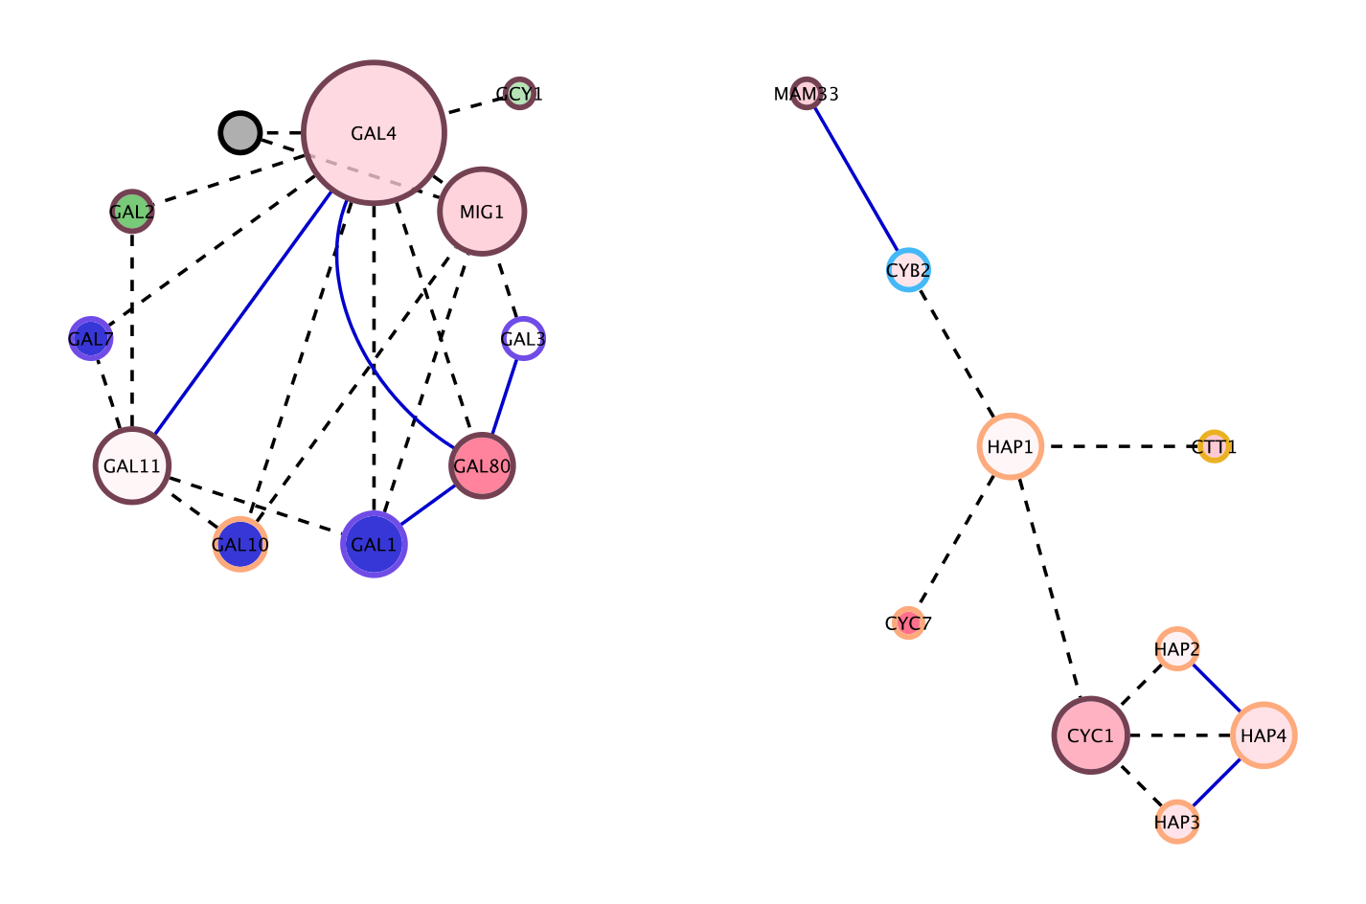
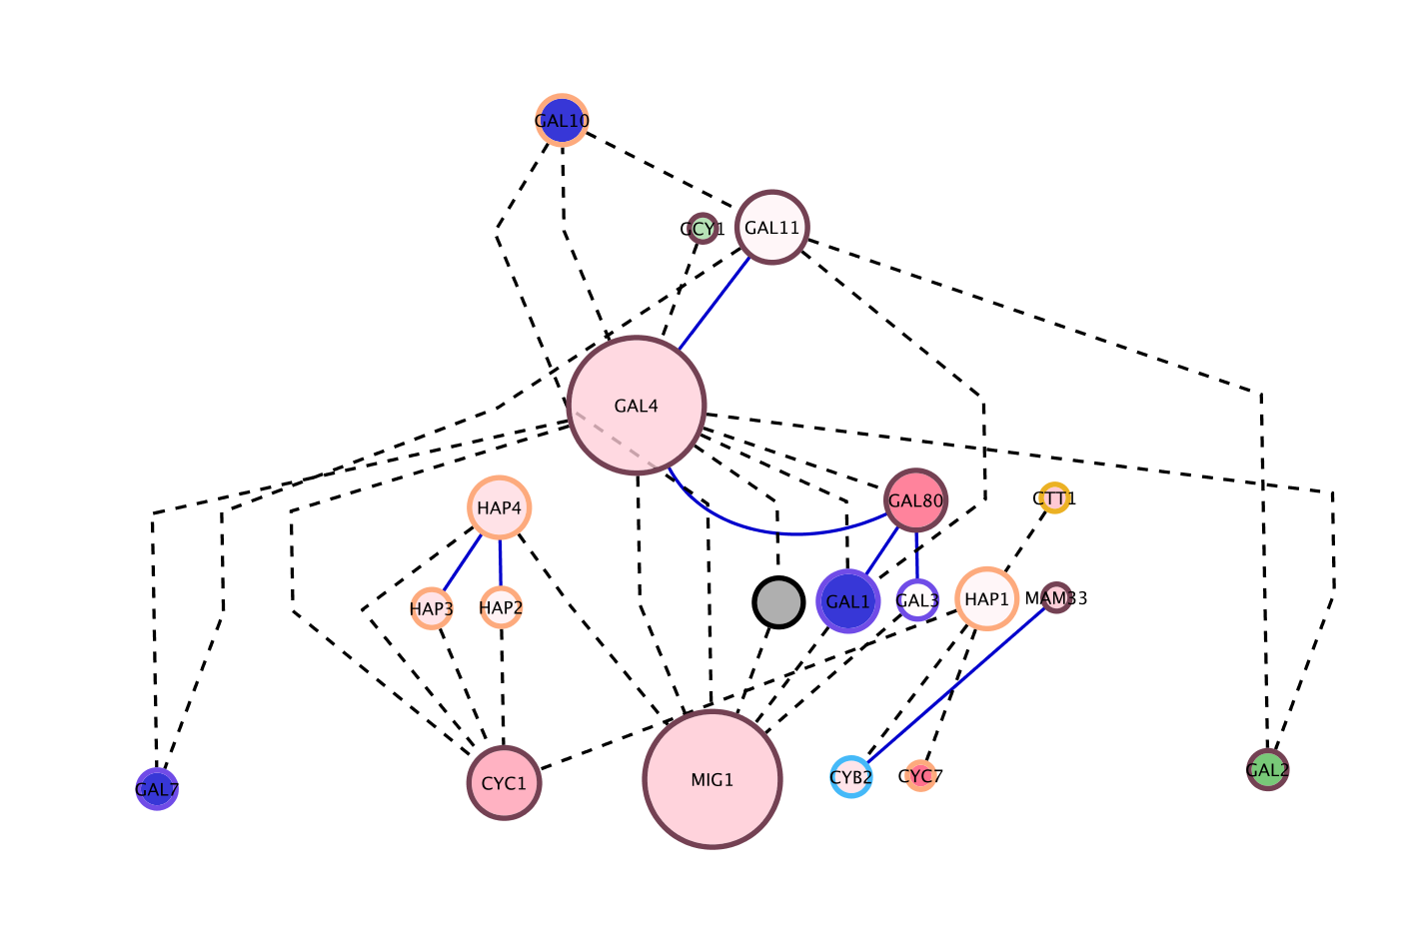




Layouts
Layouts determine the location of nodes and (sometimes) the paths of edges
Types:
  Simple
    Grid
    Partitions
  Hierarchical
    layout data as a tree or hierarchy
    Works best when there are no loops
  Circular (Radial)
    arrange nodes around a circle
    could use node attributes to govern position
      e.g. degree sorted
Notes:
Need layout examples

Slide 25



Layouts
Types:
  Force-Directed
    simulate edges as springs
    may be weighted or unweighted
  Combining layouts
    Use a general layout (force directed) for the entire graph, but use hierarchical or radial to focus on a particular portion
  Multi-layer layouts
    Partition graph, layout each partition then layout partitions
  Many, many others

Slide 26
Layouts
Use layouts to convey the true relationships between the nodes
Layout algorithms may need to be “tuned” to fit your network
Lots of parameters to change layout algorithm behavior
Can also consider laying out portions of your network

Slide 27

Animation
Animation is useful to show changes in a network:
  Over a time series
  Over different conditions
  Between species

Slide 28
Cytoscape
About Cytoscape:
  “Cytoscape is an open source bioinformatics software platform for visualizing molecular interaction networks and integrating these interactions with gene expression profiles and other state data.” – Cytoscape Web Site

Slide 29

What is Cytoscape?
  www.cytoscape.org
  Visualization
  Integration
  Analysis

Slide 30




What is Cytoscape?
  Open source
  Cross platform
  A consortium
University of Toronto
University of Michigan
Unilever

Slide 31
Demonstration
Cytoscape Demo
  Vizmapper
  clusterMaker
  structureViz
  chemViz

Slide 32
Questions?
Thanks for your attention!

Slide 34
Workshop: Cytoscape
John “Scooter” Morris, Ph.D.
Resource for Biocomputing, Visualization, and Informatics, UCSF

Slide 35
Cytoscape
About Cytoscape:
  “Cytoscape is an open source bioinformatics software platform for visualizing molecular interaction networks and integrating these interactions with gene expression profiles and other state data.” – Cytoscape Web Site

Slide 36
What is Cytoscape?
  www.cytoscape.org
  Visualization
  Integration
  Analysis

Slide 37
What is Cytoscape?
  Open source
  Cross platform
  A consortium
University of Toronto
University of Michigan
Unilever

Slide 38


Core Concepts
Networks and Annotations
Networks
e.g, biological pathways
Annotations
e.g., attributes or data
Notes:
Notes: it is a Cytoscape goal that both the graph model and the data are free from Biological semantics

Slide 39
Core Concepts
Visual Mapping with VizMapper
Networks
Annotations
VizMapper
Notes:
Notes: it is a Cytoscape goal that both the graph model and the data are free from Biological semantics
Mention water distribution network publication
39

Slide 40






Visual Styles
Use specific line types to indicate different types of interactions
Encode specific physical entities as different node shapes.
Set node sizes based on the degree of connectivity of the nodes.
Browse extremely dense networks by controlling for the opacity of nodes
Set node font sizes based on the degree of connectivity of the nodes.
Expression data
Notes:
40

Slide 41
Core Concepts
Plugins!
http://chianti.ucsd.edu/cyto_web/plugins/index.php
Notes:
41

Slide 42
Cytoscape
Traditional uses
  Visualizing:
    PPI
    Pathways
  Mapping:
    Expression profiles
    “Other state data”

Slide 43


Cytoscape

Slide 44

Cytoscape

Slide 45




Cytoscape: Platform
Cytoscape as a platform
  Plugin architecture
    http://www.cytoscape.org/plugins
  BINGO
    GO Over expression analysis
  MCODE
    Finding protein complexes
  Agilent literature search plugin
    Creating networks from the literature

Slide 46
Plugins
MCODE
Notes:
Look for complexes within a network
46

Slide 47
Plugins
BiNGO
Notes:
GO overrepresentation
47

Slide 48
Plugins
Agilent Literature Search
Notes:
Create networks from the literature
48

Slide 49
Tutorial
Start with “Introduction to Cytoscape”
  NOTE: When you get to the “WikiPathways” step (page 7), you will need to go to the Plugin Manager and load the GPML Plugin (under Network & Attribute I/O)
  Details on the Plugin Manager are available on page 11 of the handout.
Other available handouts:
  Agilent Literature Search
  ClusterMaker
  Network Analyzer
Don’t hesitate to ask questions!

Slide 50
After Today
Downloading cytoscape:
  www.cytoscape.org
Questions about cytoscape
  cytoscape-helpdesk@googlegroups.com
  cytoscape-discuss@googlegroups.com
Tutorials web site:
  http://labrador.library.ucsf.edu/opentutorials/
  http://opentutorials.rbvi.ucsf.edu/ (new URL)
My contact information:
  scooter@cgl.ucsf.edu
  http://www.cgl.ucsf.edu/home/scooter
  http://www.rbvi.ucsf.edu/cytoscape (documentation on our plugins)

Slide 51
Thanks!

Slide 52
Backup Slides

Slide 53
clusterMaker
Base Cytoscape:
  Map expression values onto network
Next step: clusterMaker
  Visualize expression heat maps
  Include standard clustering approaches
    Hierarchical, k-Means
  Provide interaction between head map and network
  Extensions:
    epistatic maps, complex determination

Slide 54






clusterMaker

Slide 55
structureViz
Base Cytoscape:
  Show protein-protein pathways and interaction networks
Next step: structureViz
  Use node and edge annotations to provide structural references:
    PDB files
    Functional residues
    Links to modeled structures
  Visualize structures in UCSF Chimera
    Provide interaction between structure and network
    Provide simplified interface to structural elements

Slide 56

structureViz

Slide 57
chemViz
Base Cytoscape:
  Visualize pathways
    Color nodes by drug screening results
Next step: cheminfo plugin (chemViz?)
  Use node and edge annotation to provide chemical descriptors
    SMILES strings, InChi fingerprints
  Visualize structures
  Cheminformatics calculations
    Tanimoto similarity
    Chemical descriptors (e.g. Rule of Five, Hydrogen Bond Donor and Acceptor count)

Slide 58

chemViz

